Slide 1


Slide 2


Modernize ConfigMgr OSD with Community Tools

Slide 3



Peter Löfgren
Senior Consultant - TrueSec
@LofgrenPeter
peter.lofgren@truesec.se
Nickolaj Andersen
Principal Consultant - TrueSec
@NickolajA
nickolaj.andersen@truesec.se

Slide 4
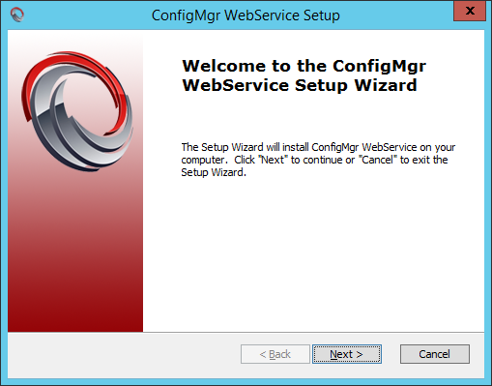
ConfigMgr WebService
Server side data processing
Integrates with:
ConfigMgr, MDT, SQL and AD
Install on any web server
Wizard driven installation or manual
Supported platforms:
Windows Server 2012 R2 and 2016
ConfigMgr Current Branch

Slide 5
ConfigMgr WebService

Slide 6
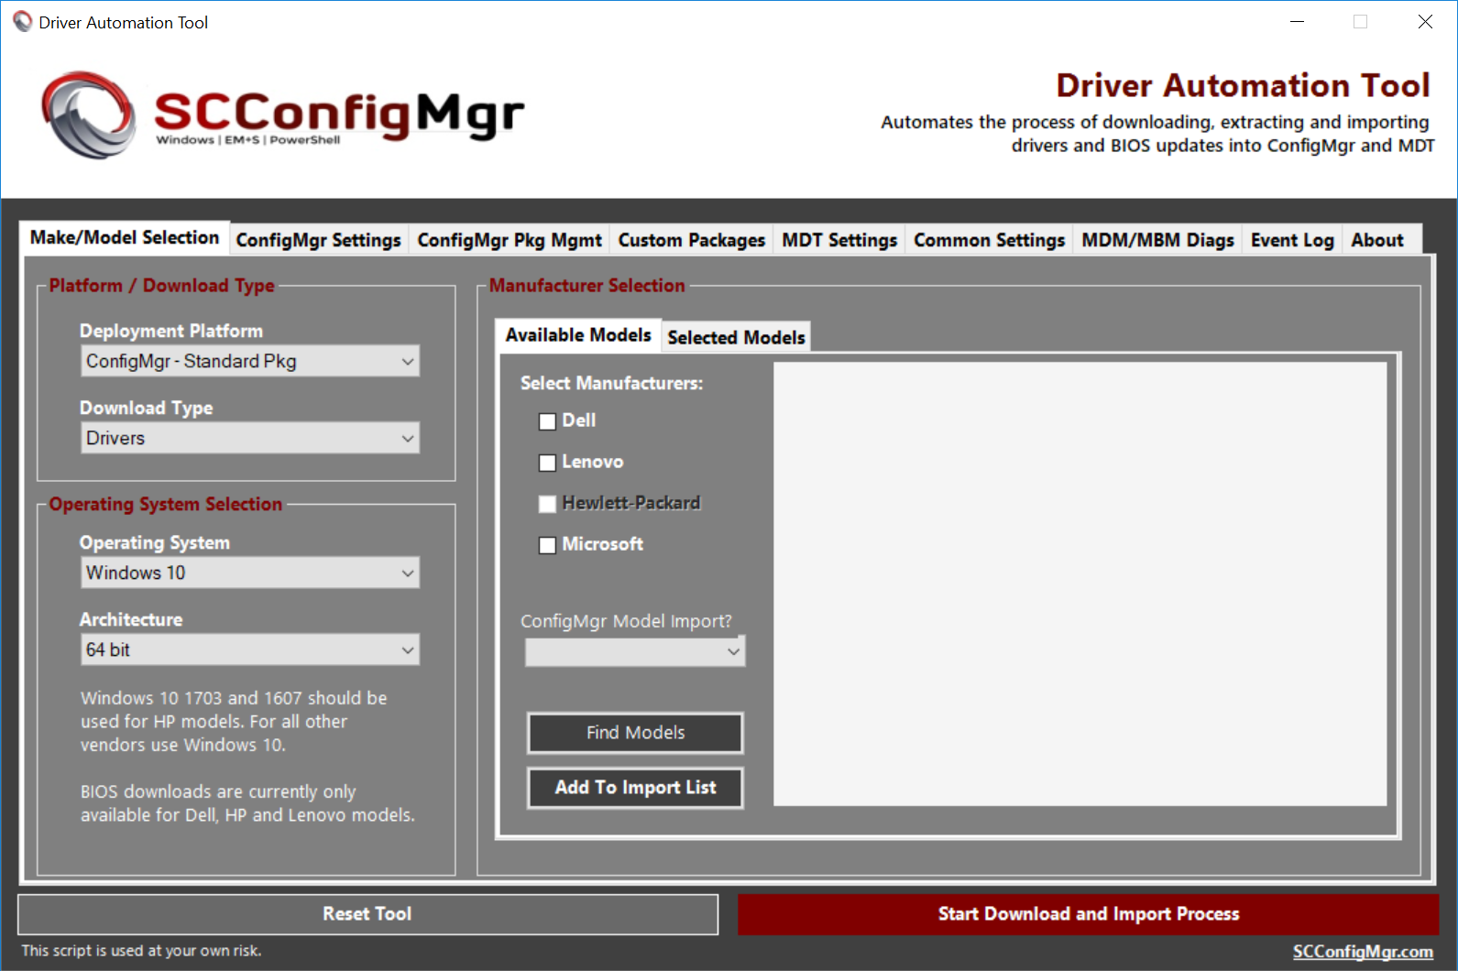
Modern Driver Management
Vendor and model detection
Dell, Lenovo, HP, and Microsoft
Download drivers packages with Driver Automation Tool
Manually or scheduled
Single task sequence step
Detect, download and apply (DISM)
Uses Packages
Uses ConfigMgr WebService
Supported scenarios:
BareMetal
In-Place Upgrade
Driver Update

Slide 7
Modern Driver Management
Notes:
# Demo med BareMetal, In-Place Upgrade och DriverUpdate

Slide 8
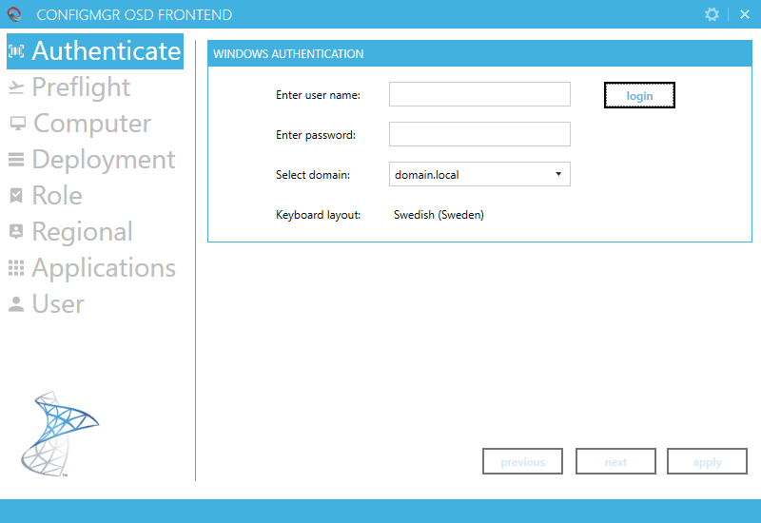
ConfigMgr OSD FrontEnd
Device configuration at deployment
Bare-metal and Refresh scenarios
Integrated with ConfigMgr and MDT
Authenticated users
Restricted task sequences
Enable / Disable sections
Roles, Regional, Apps, User
Install applications
Customizable branding and more

Slide 9
ConfigMgr OSD FrontEnd
Notes:
# Demo med BareMetal, In-Place Upgrade och DriverUpdate

Slide 10
Language Packs for In-Place Upgrade
Use with Windows servicing (task sequence based)
Detect installed language packs
Detects default system culture
OSDSetupAdditionalUpgradeOptions
/InstallLangPacks
/Compat IgnoreWarning

Slide 11
Language Packs for In-Place Upgrade
Notes:
# Demo med BareMetal, In-Place Upgrade och DriverUpdate

Slide 12
Resources
ConfigMgr WebService
https://gallery.technet.microsoft.com/ConfigMgr-WebService-100-572825b2
ConfigMgr OSD FrontEnd
https://gallery.technet.microsoft.com/ConfigMgr-OSD-FrontEnd-100-55209031
Modern Driver / BIOS Management
http://www.scconfigmgr.com/modern-driver-management/
http://www.scconfigmgr.com/modern-bios-management/
http://www.scconfigmgr.com/driver-automation-tool/
Language Packs for In-Place Upgrade
https://github.com/SCConfigMgr/ConfigMgr/blob/master/Operating%20System%20Deployment/Language%20Pack/Invoke-CMDownloadLanguagePack.ps1

Slide 13
Q&A
Notes:
# Demo med BareMetal, In-Place Upgrade och DriverUpdate

Slide 14
Resources
Slides and demos from the conference will be available at github.com/nordicinfrastructureconference/2018 (bit.ly/2y7JhA3)

